Slide 1
Learning to Execute Programs with Instruction Pointer Attention Graph Neural Networks
Hemil Desai, Zixiang Chen, Jiafan He

Slide 2
Static analysis
Static analysis is the process of analyzing a program without executing it
code completion
bug finding
program repair
Use a statement-level control flow graph to analyze the static, where nodes represent individual statements in the source program.

Slide 3
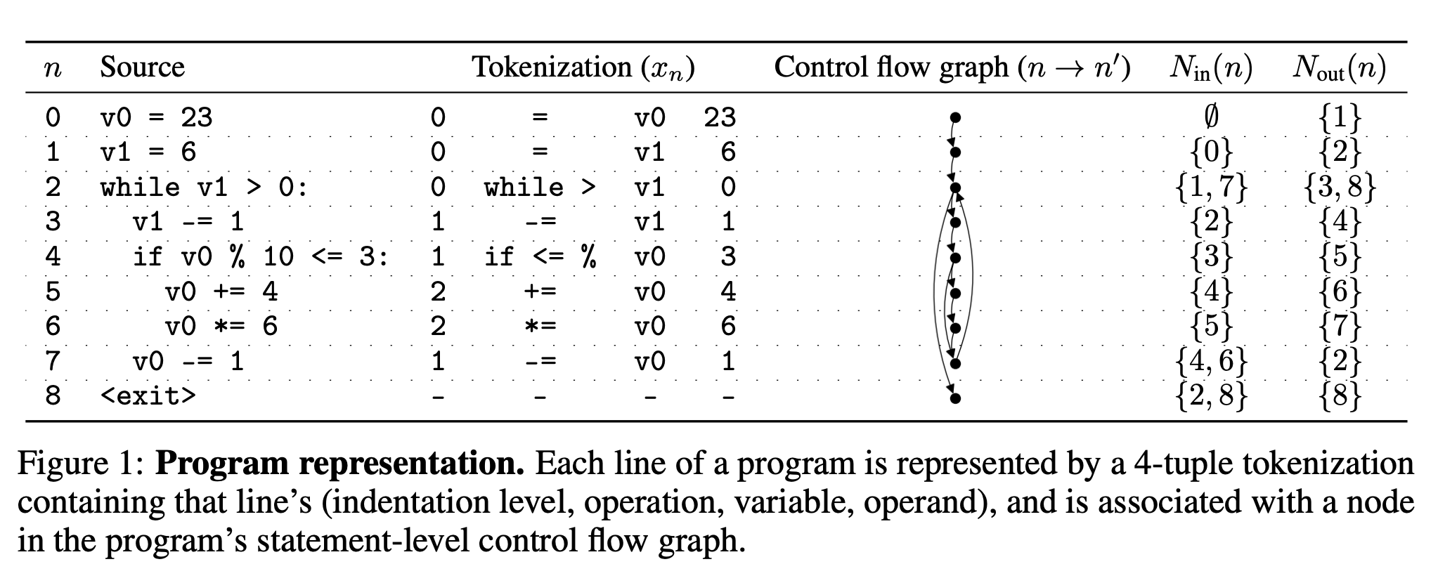
Instruction Pointer
Notes:
Control flow analysis operates on the parse tree of a program, which can be computed for any syntactically correct source file.
Instruction pointer indicates the next instruction to execute. When the control flow graph indicates two possible next statements, we call this a branch decision, and the value of the condition of the current statement determines which statement the instruction pointer will advance to.

Slide 4
Combining GNN and RNN
GNN can leverage local program structure to complete static analysis tasks
Parse trees
Control flow graphs
Data flow graphs
RNN suited for sequential reasoning, but provide no mechanism for learning about complex program structures.
Not suited for treasoning about program execution！
Notes:
GNN is suitable for learning from program structures such as …
Hower are not well suited for tasks that involve reasoning about program execution.

Slide 5
Learning to Execute as Static Analysis
Access: Textual source of a program
May Access: Parse tree of the program, Common static analysis results(program’s control flow graph)
Not Access: Compiler or interpreter for the source language, dependencies, a test suite, other unavailable artifacts.
Notes:
Motivated by the real-world setting of static analysis, we introduce two variants of the “learning to execute” task: full and partial program execution.
not readily available for static analysis of a single file

Slide 6
Full and Partial Program execution
Full Program Execution receives a full program as input and must determine some semantic property of the program, such as the program’s output.
Canonical, sequential steps of reasoning
Partial program execution task is similar to the full program execution task, except part of the program has been masked.
Benefit the requirements of designing a heuristic function
Notes:
Full program execution is a canonical task that requires many sequential steps of reasoning. The challenge of full program execution in the static analysis setting is to determine the target without actually running the program.
It closely aligns with the requirements of designing a heuristic function for programming by example. In some programming by example methods, a heuristic function informs the search for satisfying programs by assigning a value to each intermediate partial program as to

Slide 7
Bounded Execution
Bounded execution, restricting the model to use fewer steps than are required by the ground truth trace(Default). Choose number of steps allowed such that each loop body may be executed at least twice.
Benefits:
This forces the model to learn short-cuts in order to predict the result in the allotted steps.
In section 5, we find that the bounded execution IPA-GNN achieves better performance on certain length programs.
Notes:
This forces the model to learn short-cuts in order to predict the result in the allotted steps.
In our experiments, we use bounded execution by default. However, we compare in Section 5 to a Trace RNN model that follows the ground truth control flow, and surprisingly we find that the bounded execution IPA-GNN achieves better performance on certain length programs.

Slide 8
Limited Complexity Training
Strategy: Train on programs with limited complexity and test on more complex programs
To learn something meaningful about the language semantics and avoid overfitting
Execution traces of real-world programs are very long, on the order of thousands or even millions of steps,which is very challenging.
Notes:
In both task settings we train the models on programs with limited complexity and test on more complex programs to evaluate the models for systematic generalization. This provides a quantitative indication of whether the models are not only getting the problem right, but getting it right for the right reasons – because they’ve learned something meaningful about the language semantics. We expect models that exhibit systematic generalization will be better suited for making predictions in real world codebases, particularly when new code may be added at any time. Another perhaps less appreciated reason to focus on systematic generalization in learning to execute tasks is that the execution traces of real-world programs are very long, on the order of thousands or even millions of steps. Training GNNs on such programs is challenging from an engineering perspective (memory use, time) and a training dynamics perspective (e.g., vanishing gradients).

Slide 9
Notation
Dataset D consisting of pairs (x, y); x denotes a program, and y denotes some semantic property of the program, such as the program’s output.
A complexity function c(x) measures the complexity of the program x.
Dataset is partitioned according to c(x). D_{train} only consists only of examples (x, y) with c(x) < C while D_{test} consists of those examples (x, y) with c(x) > C.
Define x_{n} as a statement comprising the program, with x₀ denoting the start statement.

Slide 10
Notation
N_{in}(n) denotes the set of statements that can immediately precede x_{n} according to the control flow graph, while N_{out}(n) denotes the set of statements that can immediately follow x_{n}
We further define N_{All}(n) as the full set of neighboring statements to x_{n} which is a union of N_{in}(n) and N_{out}(n)
Since branch decisions are binary, we always have the cardinality of N_{out}(n) no greater than 2, but we don’t have such property for N_{in}(n) or N_{out}(n).

Slide 11
Approach - IPA-GNNs

Slide 12
Introduction
The authors aim to design models that share a causal structure with a classical interpreter which improves systematic generalization
This leads to the design of Instruction Pointer Attention Graph Neural Networks (IPAGNN)
IPAGNN takes the form of a message passing GNN

Slide 13
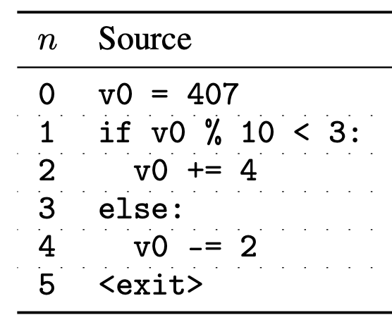
Example of a Simple Program

Slide 14
Classical Interpreters
Exhibit a simple causal structure
At each step, it maintains:
State consisting of the values of all variables
Instruction pointer indicating the next statement to execute
When a statement is executed, the state and instruction pointer is updated
A natural architecture for modeling this is Recurrent Neural Networks

Slide 15
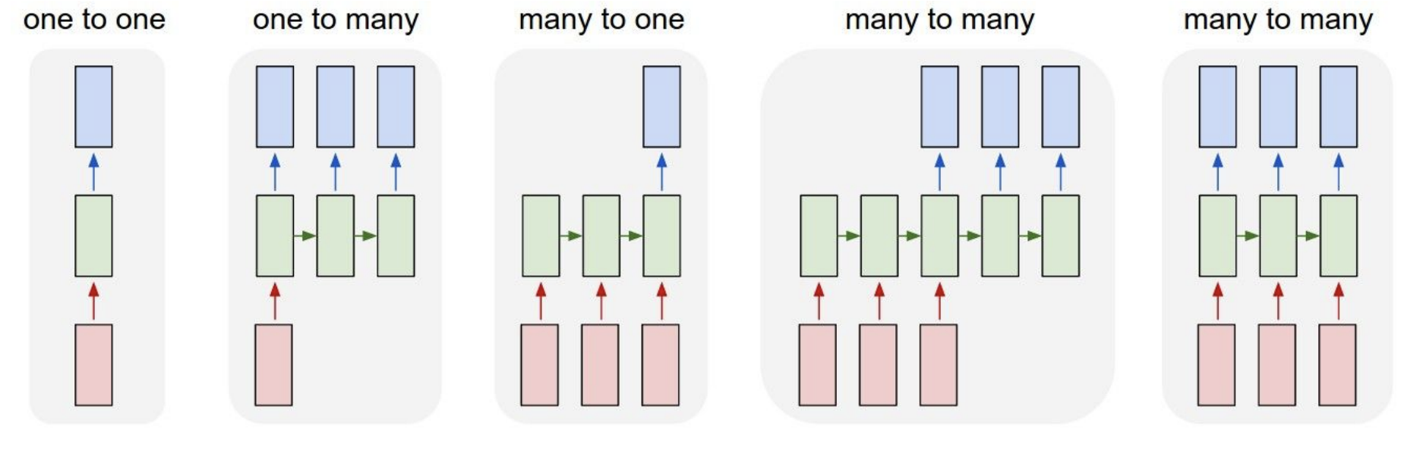
Background - RNNs
http://cs231n.stanford.edu/slides/2017/cs231n_2017_lecture10.pdf

Slide 16
Background - RNNs
https://towardsdatascience.com/illustrated-guide-to-lstms-and-gru-s-a-step-by-step-explanation-44e9eb85bf21

Slide 17
Background - Vanishing Gradients
https://towardsdatascience.com/illustrated-guide-to-recurrent-neural-networks-79e5eb8049c9

Slide 18
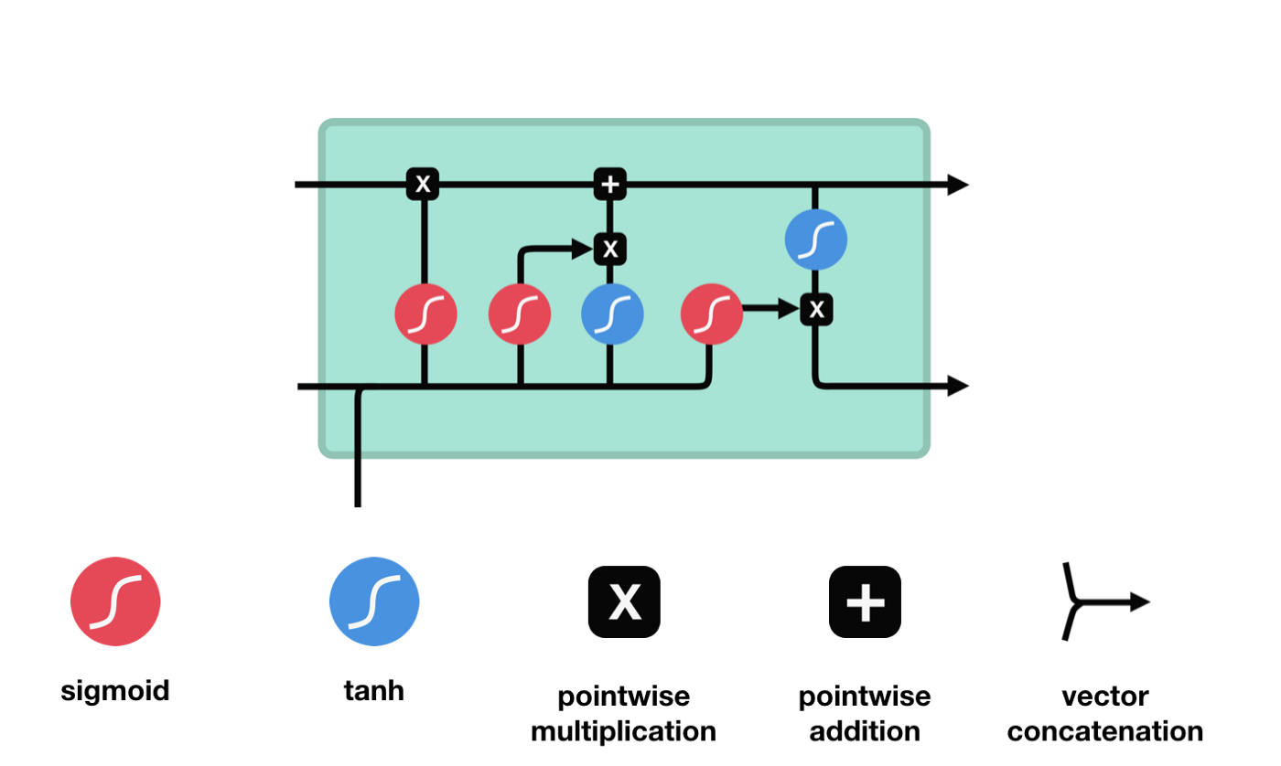
Background - LSTMs
https://towardsdatascience.com/illustrated-guide-to-lstms-and-gru-s-a-step-by-step-explanation-44e9eb85bf21

Slide 19
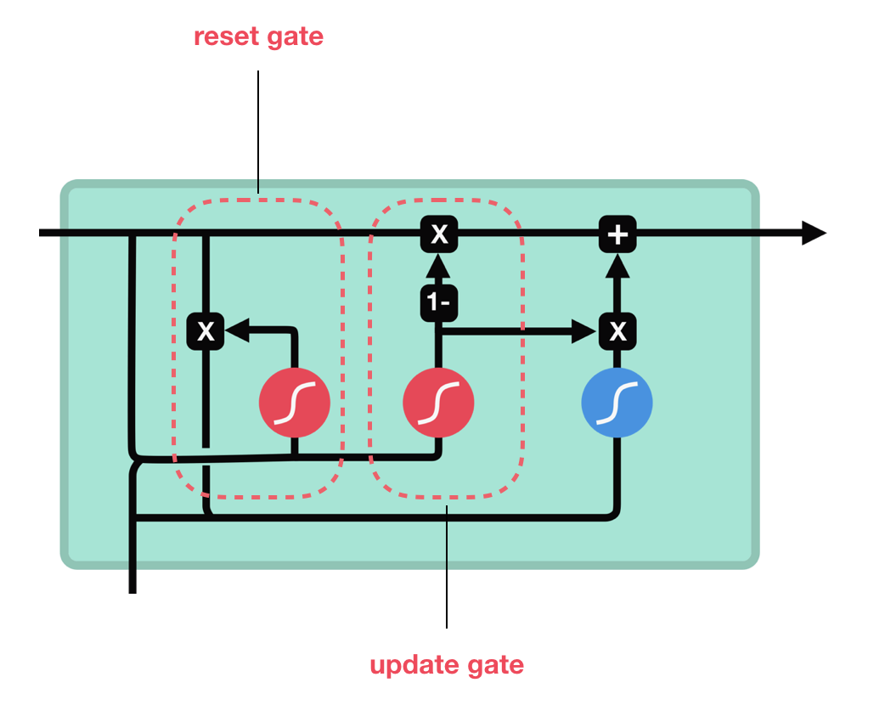
Background - GRU
https://towardsdatascience.com/illustrated-guide-to-lstms-and-gru-s-a-step-by-step-explanation-44e9eb85bf21

Slide 20
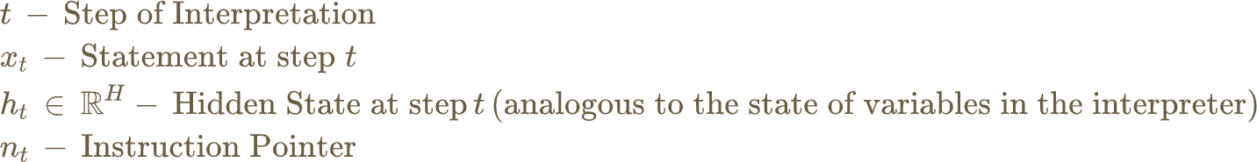

IP-RNNs
Notation:
Line by Line RNN:
Instruction Pointer RNN: A family of RNNs with different definitions for the instruction pointer

Slide 21
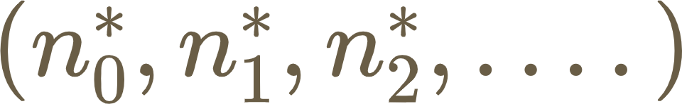
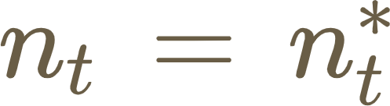
Trace RNNs
When program has control flow statements, the authors introduce latent branch decisions to IP-RNNs
RNN processos some path through the program determined by the latent branch decisions
The simplest model is just an IP-RNN which has access to an oracle that will tell you the correct next statement.
This oracle has the ground truth trace of the program -
Trace RNN is when

Slide 22
Hard IP-RNN
In real world scenarios, you won’t have access to such an oracle
If you use a Dense Layer on top of the hidden state and use hardmax you get the Hard IP-RNN
However, argmax is non differentiable

Slide 23

IPA-GNNs
Continuous Relaxation of the Hard IP-RNN
IPAGNN makes soft branch decisions by modeling a probability distribution over the instruction pointer
Soft instruction pointer
Each t,n pair has its specific hidden state

Slide 24
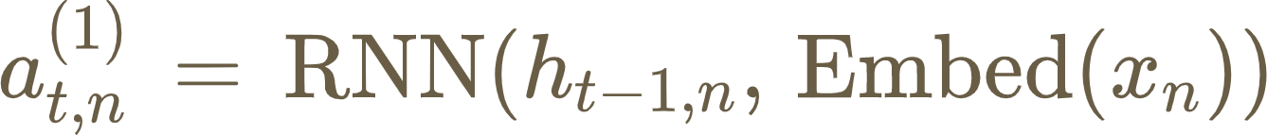
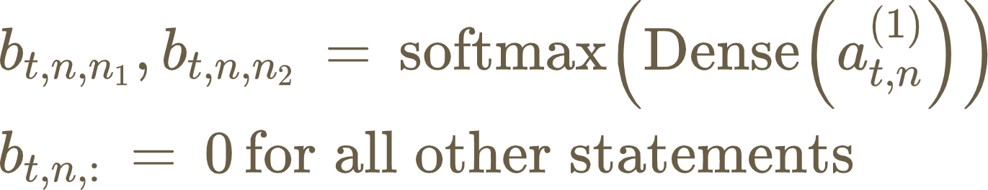
Execute and Branch
An RNN step over each statement n produces a respective state proposal
In straight line code,
In general, model computes a soft branch decision
When

Slide 25
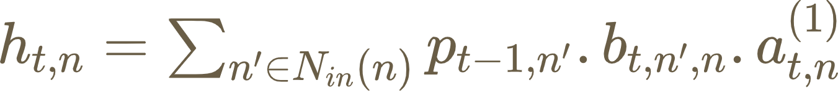
Aggregate
Hidden State
Soft Instruction Pointer

Slide 26
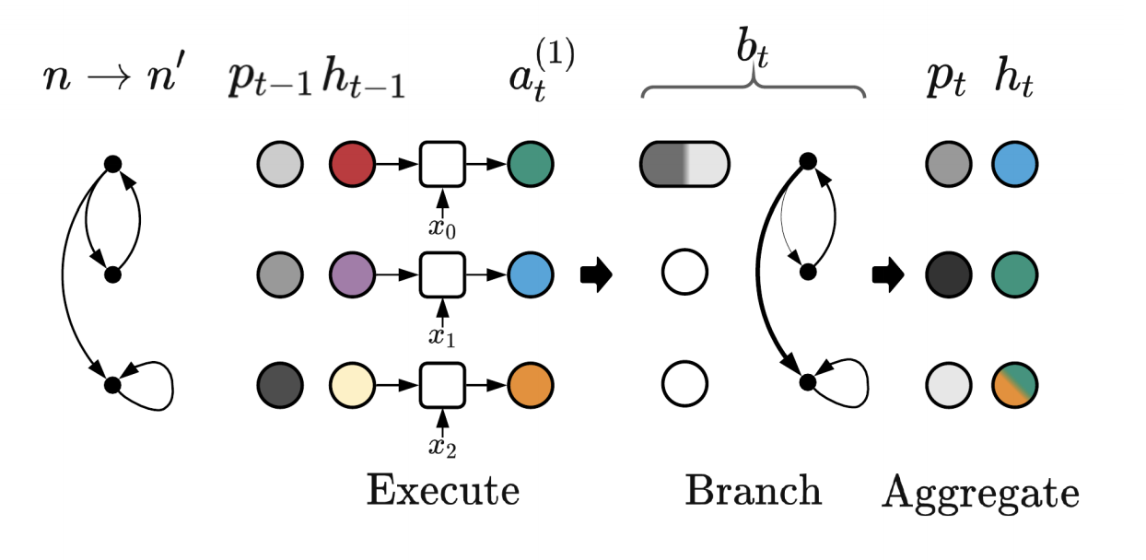
Single IPA-GNN layer

Slide 27
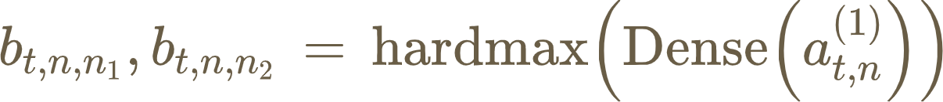
Relationship with IP-RNNs
If soft branch decisions saturate, we get the Hard IP-RNN
If Hard IP-RNN makes the correct decisions, we get Trace RNN
If program is straight line code, we get line by line RNN

Slide 28
Relation with Gated Graph Neural Networks (GGNN)
GGNN operate on the bidirectional form of the control flow graph
4 possible edge types - True or False branch, Forward or Reverse edge
Two changes in IPA-GNN from GGNN:
RNN over a statement analogous to the execution of one line of code
Soft instruction pointer and attention analogous to the control flow of an interpreter
Selectively replacing these components yields networks in between the two

Slide 29
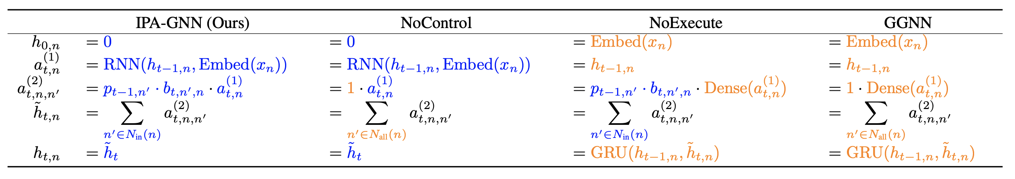
Relation with Gated Graph Neural Networks (GGNN)
Blue - IPA-GNN Orange - GGNN

Slide 30
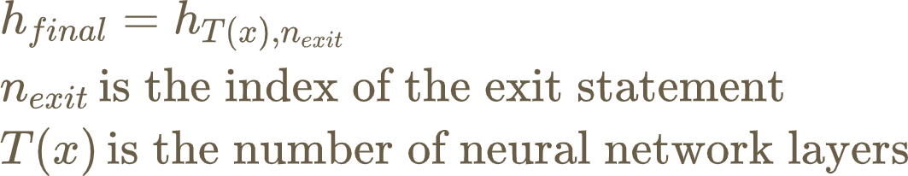
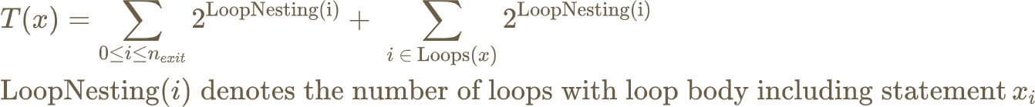
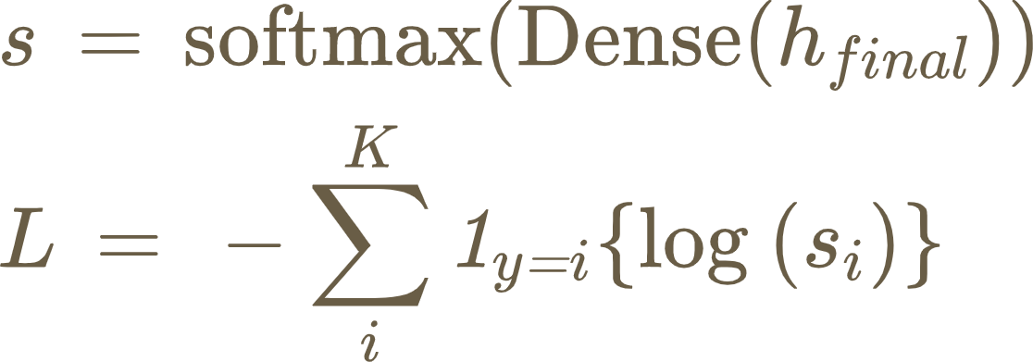
Implementation Details
Final hidden state is computed as
Logits and loss is calculated as

Slide 31
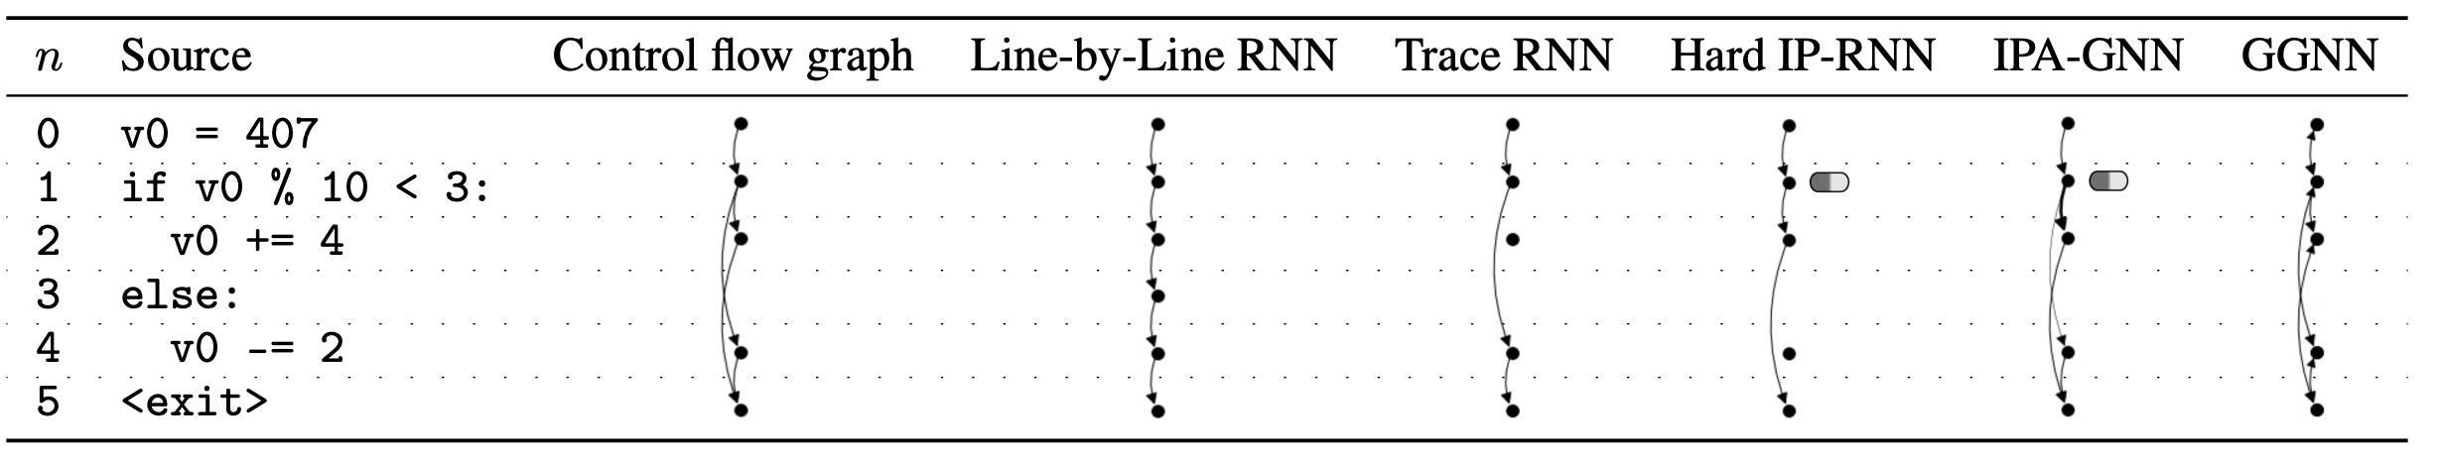
Recap

Slide 32
Experiment
Data generation
Model training
Experiment result
Notes:
1: Hello, I am Jiafan and I will talk about the experiment in this paper. The experiment consists of three different parts: Data generation, Model training and Experiment result.

Slide 33
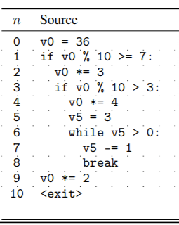
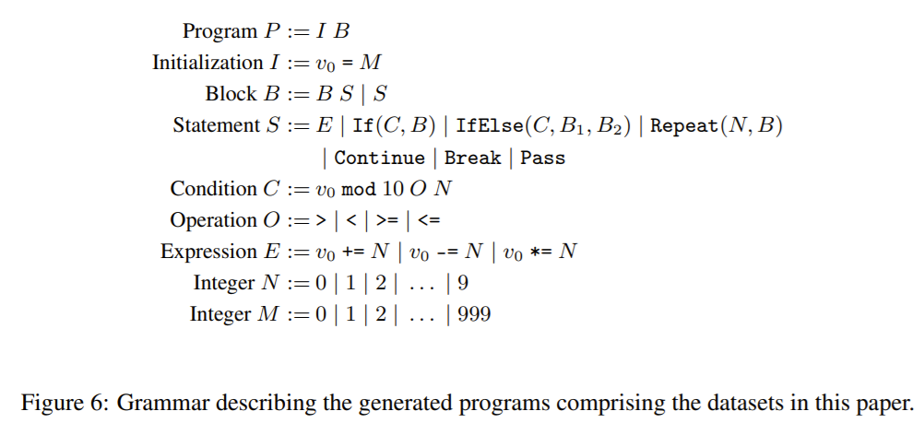
Data set:
● Limited Python programming language
● Generated by a probabilistic grammar
Notes:
2: This paper focus on static analysis tasks with limited python programming language. The limited python programming is randomly drawn from the following probabilistic grammar and this is a example of the generated programs.

Slide 34
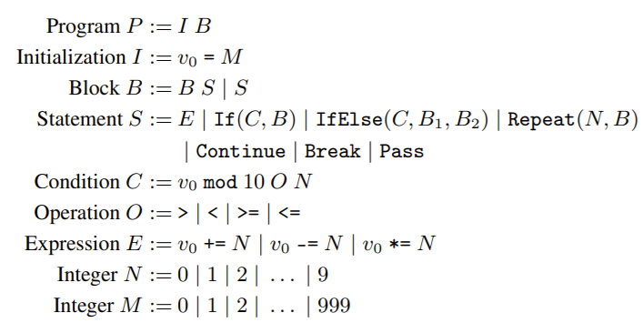
Grammar and Data Generation
Program
P
Notes:
3: For the Data Generation, we first use this example to illustrate how to generate a python programming from the probabilistic grammar. Firstly, we want to generate a program which is denoted by P in the grammar.

Slide 35
Grammar and Data Generation
Program
I B (rule P:= I B)
Notes:
4: Now, according to the rule P is equal to I B, and we replace the program P to an initialization I and a block B.

Slide 36
Grammar and Data Generation
Program
v0 = M (rule I:= v0 = M)
B
Notes:
5. Similarly, we can replace the initialization I to the statement v-zero equal to an integer M.

Slide 37
Grammar and Data Generation
Program
v0 = 36 (rule M:= 36)
B
probabilistic grammar
M= 0 | 1 | 2 | … | 999
Notes:
6. Now, for the integer M, it can be illustrated as zero, one, ... to 999 by the rule. In this case, the probabilistic grammar uniformly random choose a rule and illustrate the integer M with this rule.

Slide 38
Grammar and Data Generation
Program
v0 = 36 (rule M:= 36)
B S (rule B:= B S)
def generate_block(indent, in_loop=False):
global length
if length > COMPLEXITY - 1:
return generate_statement(indent, in_loop=in_loop)
b = random.randint(0, 1)
if b == 0:
s, in_loop = generate_block(indent, in_loop=in_loop)
new_s, in_loop = generate_statement(indent, in_loop=in_loop)
s += new_s
return s, in_loop
else:
return generate_statement(indent, in_loop=in_loop)
probabilistic grammar
B:= B S | S
Notes:
7. More detail can be found in the code. For example, here is the code used to generate a block B. As we can see, there are two rules to illustrate a block B in the grammar and in the program, we uniform choose a variable b. When b equal to zero, we generate a block s and a statement new_s, which corresponding the first rule B equal to a block B and a statement S. When b equal to one, the block B is equal to a statement S.

Slide 39
Grammar and Data Generation
Statement S = Repeat (N,B)
Repeat (3,B)
Random variable v1,...,v9 for Repeat statement
Notes:
8. Other part of the code is similar to the block-generated code and I will not show all the code in the presentation. But if you compare the grammar and the example program carefully, you will find that the variable and the while statement doesn't appear in the grammar. In fact, the variable v-five and the while-loop statement is part of the repeat statement.

Slide 40
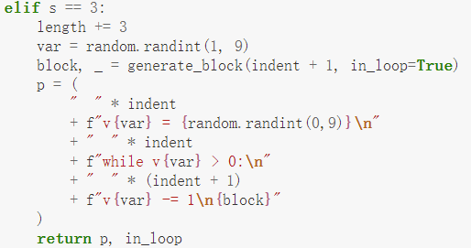
Grammar and Data Generation
Statement S = Repeat (N,B)
Repeat (3,B)
Random variable v1,...,v9 for Repeat statement
Notes:
9. Here is part of the statement generation code. As we can see, we firstly uniform random choose a variable from v1,...,v9 and number of iterations from 0 to 9. Then we realize the repeat statement through while loop in python programming language.

Slide 41
Data set:
● Limited Python programming language
● Generated by a probabilistic grammar
Limited Statement
Multi-digit arithmetic (+,-,*) for v0
(0,1,..,999)
While-loops with variable
(v1,..,v9) (0,1,..,9 iterations)
If-else statement with variable
V0 (>,<,>=,<=)
Notes:
10. According the grammar, these tasks only capture a subset of the Python programming language. To be more specific, each program in date set only allows multi-digit arithmetic for v0. If-else statement with variable V0 and While-loops statement. Furthermore, the range of the value is limited by 1000 and other variable v1, to v9, only appear in while loops.
the variable assignments for v0 is limited by 1000.
The programs in our experiments were limited in the number of variables considered, in the magnitude of the values used, and in the scope of statements permitted

Slide 42
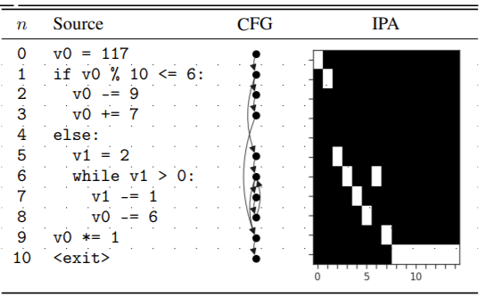
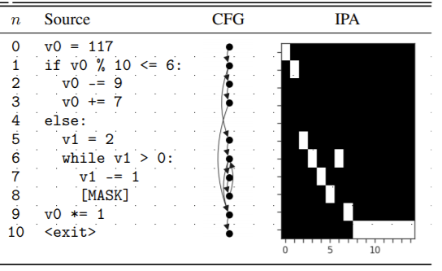
Partial program
Masking one statement
Uniformly random
Non-control flow statements (remain same execution behavior)
Notes:
11. After generating full program, we then mask one random statement and generate the partial program. Here, the masked statement is uniform random chosen from all non-control flow statements and the partial program remain same execution behavior as the full program. This is a example of full program and partial program. In this example, we can mask statement 2, statement 3, statement 8, statement 9, but we can not mask the statement 5, which is related to the execution behavior. Furthermore, for this program, the statement 2 and 3 will not be executed. Thus, masking statement 8 will change the result and masking statement 2 or 3 will not change the final output.

Slide 43
Limited Complexity Training
Strategy: Train on programs with limited complexity and test on more complex programs
Complexity measure c(x): program length
Complexity threshold for training data: c(x)=10 (5M examples)
Complexity threshold for test data: c(x)={20,30,..,100} (4.5K)
Target function y=f(x): the final value of v0 (mod 1000)
Notes:
12. In this work, the model is training with limited complexity program and test on more complex programs. To be more specific, the complexity measure in this paper is the program length and target function is the final value of variable v0. In addition, the training data sets include 5 million programs with program length equal to 10 and the test data sets include 4500 programs with program length equal to 20, 30, to 100

Slide 44
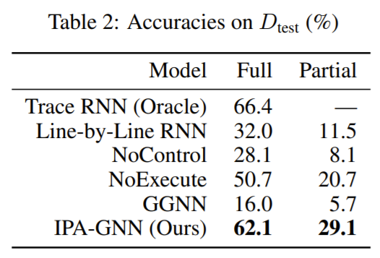
Training and Experiment results
1. Adam optimizer
+ standard cross-entropy loss
2. Training with different parameter and choose the best model parameters by cross-validation
Hidden layer : 200,300
Learning rate: 0.003, 0.001, 0.0003, 0.0001
Notes:
13. For both full programs and partial programs, we evaluate the IPA-GNN model against other baseline models, such as Line-by-Line RNN, R-GAT, No-Control model , NoExecute model , and GGNN model. For the Trace RNN, it requires access to a trace oracle and we only implement it on full program tasks. For each model, We use adam optimizer with standard cross-entropy loss, train with different parameter and choose the best model parameters by cross-validation. The experiment result is shown in the table. We can find that Tracee RNN obtain result due to the access of a trace oracle and the IPA-GNN model outperforms all other baselines.

Slide 45
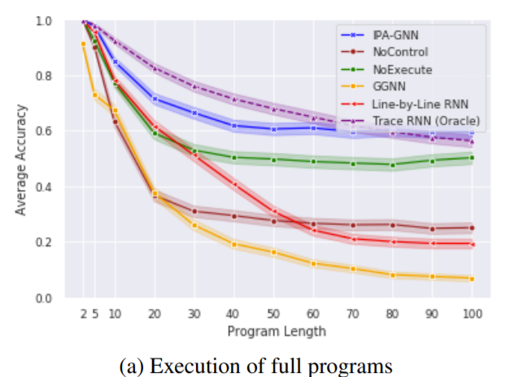
Full programs with different length
1. Trace RNN outperforms all model except IPA-GNN
2. IPA-GNN outperforms all other models
3. Line-by-Line RNN model performs almost as well as the IPA-GNN at low complexity
Notes:
14. This paper also shows the accuracy rate of different model with different program length. As we can see, Trace RNN outperform nearly all models for all program length, but still worse than IPA-GNN when program length larger than 80. IPA-GNN outperforms all other models and Line-by-Line RNN model performs almost as well as the IPA-GNN at low complexity.
NoExecute significantly outperforms NoControl, indicating the importance of instruction pointer attention for the IPA-GNN model.

Slide 46
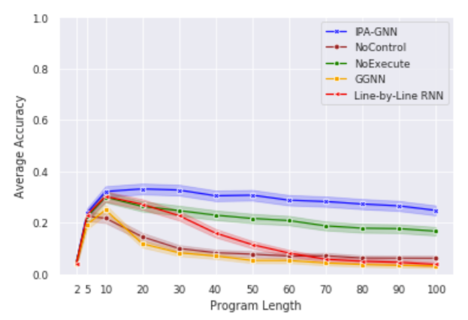
Partial programs with different length
1.Rapid rise （length<10）
2.Slowly decrease (10<length)
Notes:
15 The accuracy rate of partial program is shown in this graph. In these tasks, IPA-GNN model also outperforms all other baseline models.
Compared with the result of full program tasks, the accuracy rate first rapidly increase and then slowly decrease.

Slide 47
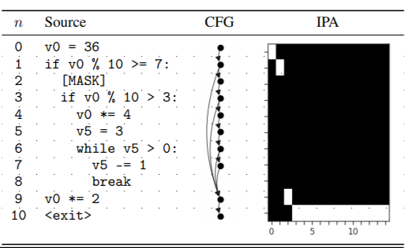
Partial programs with different length
Notes:
16 However, this phenomenon is reasonable. For a partial program, the output will not change if we mask a not-executed statement. For example, in this program, v-zero mod twn is equal to six and the program will not execute the statement two and whatever the original statement is, the output will not change. When the length of program is small, nearly all statements will execute and mask each statement will lead to wrong output. When the length of program is large enough, the rate of executed statement become stable and the accuracy decrease.

Slide 48
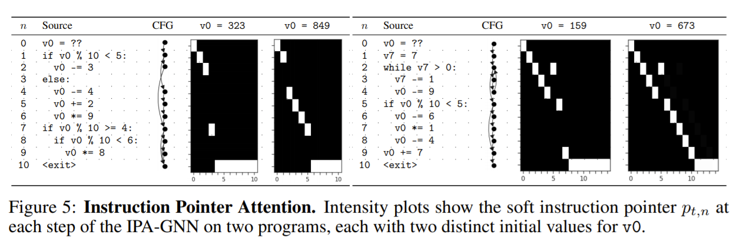
Other Observation of IPA-GNN
1.Discrete branch decisions
2. Short-circuit execution
Notes:
17. Finally, this paper also show some other observations of the IPA-GNN model. Here are two example programs. This figure shows the values of the soft instruction pointer over these four predictions, and we can find that the IPA-GNN model usually produce discrete branch decisions. For the second program, the while-loop statement should execute 7 times and the figure shows that the model attends to the while-loop body only once, which means these model also learns to short-circuit execution.

Slide 49
Thanks for Listening!
Notes:
That’s all of our presentation, thanks for listening.

